Slide 2
Agenda
Dynamic Network Gephi
Graph building
Extracting Seeds from the large graph
Procurement and Travel channels
Extracted graphs

Slide 3
Dynamic Network in Gephi
Graph over time
Interactive
Notes:
Interactive
Filter
Time
Color, size, edge color
Graph Measurements: from number of nodes and edges to graph density, PageRank and so on
Comparing graphs
Layout

Slide 4
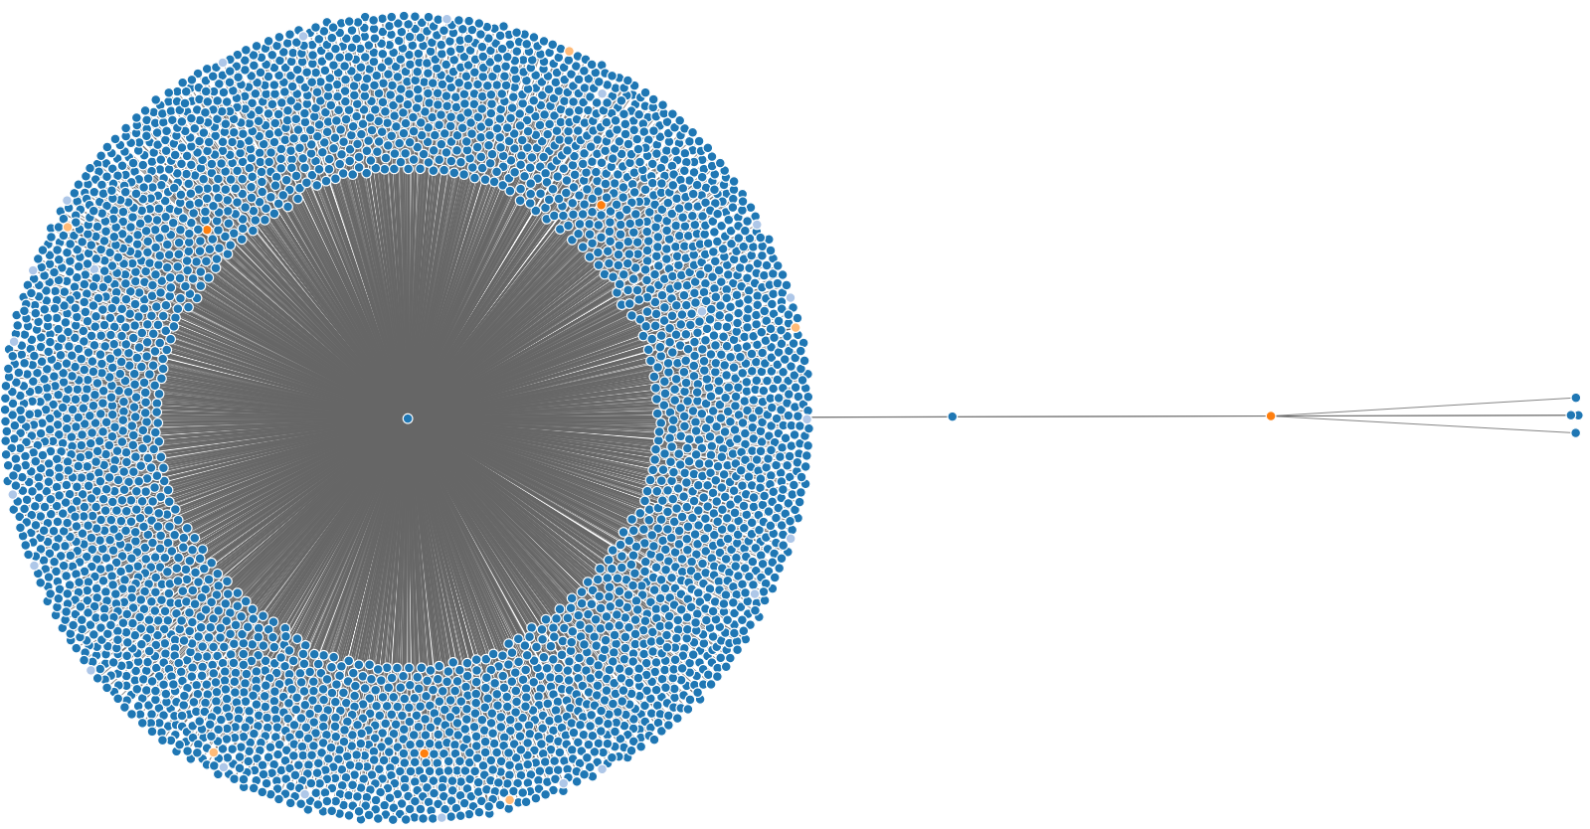

Graph Building 1
Step 2:
Finding directly connected
nodes
Step 1:
Locating the Seed

Slide 5
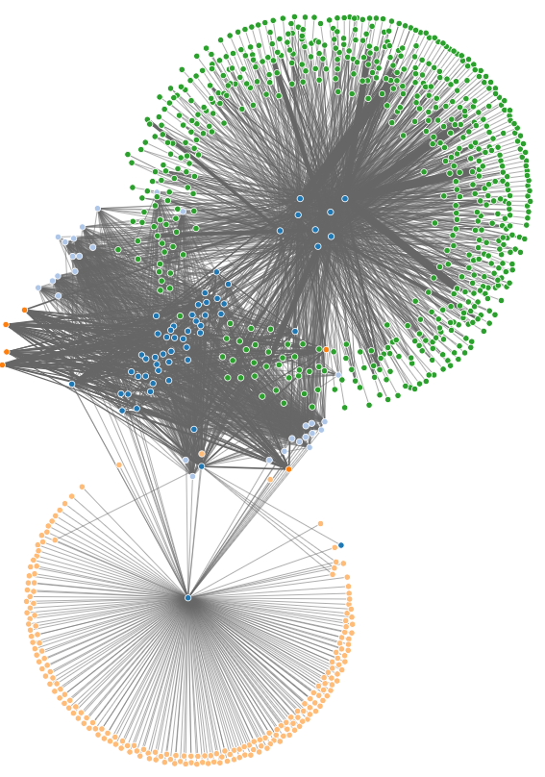
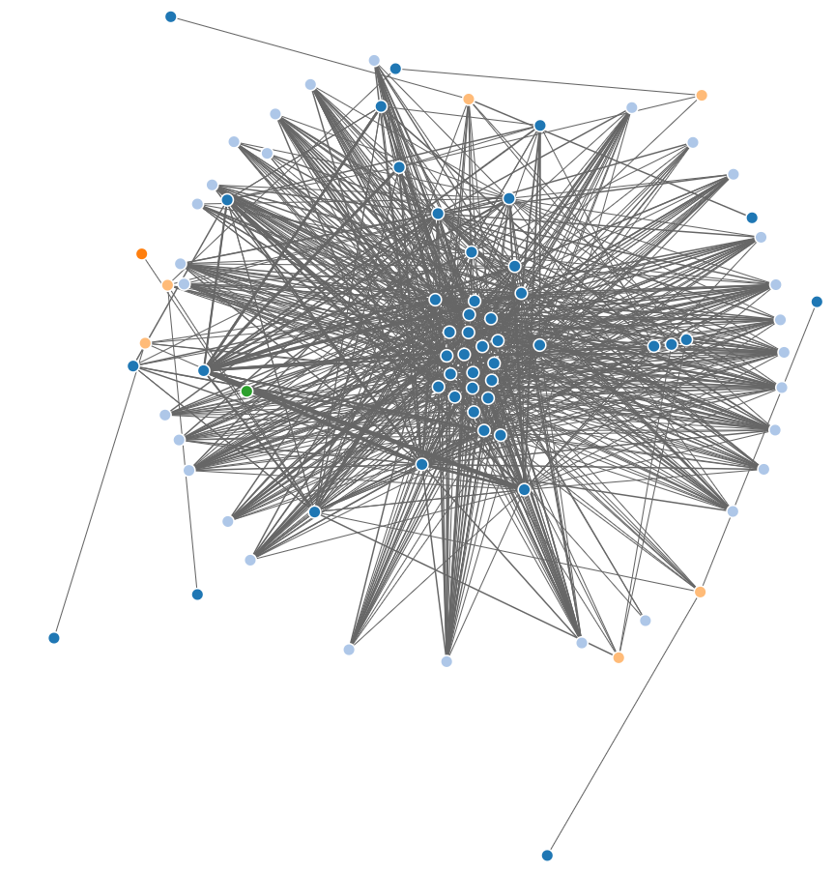
Graph Building 2
Step 3:
Accumulating the
prominent nodes
Step 4:
Finalizing the network

Slide 6
Graph building 3
d
Notes:
Seeds
Four major steps to create graphs
Step 1: Locating the Seed
Step 2: Finding directly connected nodes
Step 3: Accumulating the prominent nodes
Step 4: Finalizing the network.

Slide 7
Extracting Seeds from the large graph
Channel Visualization and analysis
Choosing appropriate channels

Slide 8
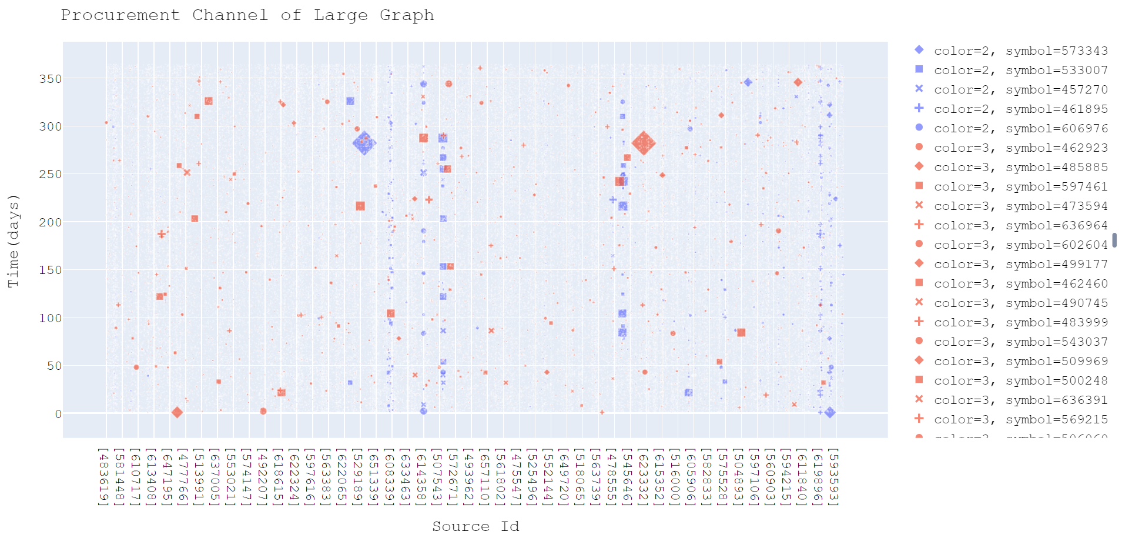
Procurement Channel
H

Slide 9
Travel channel
d

Slide 10
Filtering the Seeds
Many clusters from travel
Few node pairs from Procurement
Finding the travel channel for the pairs
Finalizing the seeds
Creating the graphs

